Slide 1
Week 2: “At the court of Philip the Good of Burgundy, ca. 1450”
Philip the Good, duke of Burgundy, presented with Chroniques de Hainaut (ca. 1447)

Slide 2
The duchy of Burgundy
One of the most important political, intellectual, and cultural centers of 15th-century Europe
A virtually independent principality that united large territories in France and the Low Countries
Major “player” in pan-European affairs, including 100-Year War; influence in France, England, Italy, Holy Roman Empire
Nominal capital: Dijon; in reality, an itinerant court, alternatively set in Brussels, Bruges, Lille, and Ghent

Slide 3
The duchy of Burgundy under Philip the Good (1419-67)
Philip III (aka Philip the Good), duke of Burgundy: the most powerful of the Burgundian dukes, ruled for almost 50 years; “Grand Duke of the West”
Scion of French royal house Valois, cousin/rival to both the French & English kings; expanded Burgundian territories and alliances
Philip’s court: the most brilliant and celebrated in Europe
Acknowledged leader of manners, taste, fashion, and the arts
Order of the Golden Fleece (est. 1430) – Europe’s most prestigious chivalric order
Patronage is extended to scholars, writers, artists, musicians

Slide 4
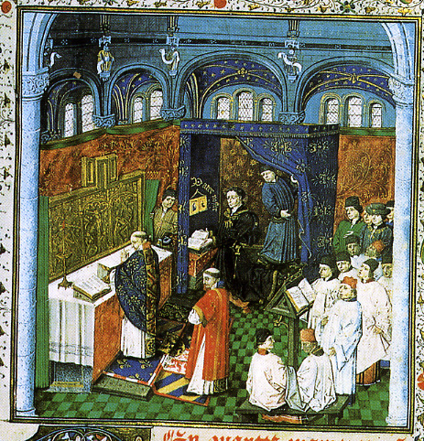
The duchy of Burgundy under Philip the Good (1419-67)
Philip III (aka Philip the Good), duke of Burgundy: the most powerful of the Burgundian dukes, ruled for almost 50 years; “Grand Duke of the West”
Scion of French royal house Valois, cousin/rival to both the French & English kings; expanded Burgundian territories and alliances
Philip’s court chapel (musical establishment): one of the largest in Europe
23 singers, with additional instrumentalists and staff
Perform both secular and sacred music (i.e., daily church services)
Lifetime job security, good salaries, promotions, pensions guaranteed by written contracts – these jobs were coveted!

Slide 5
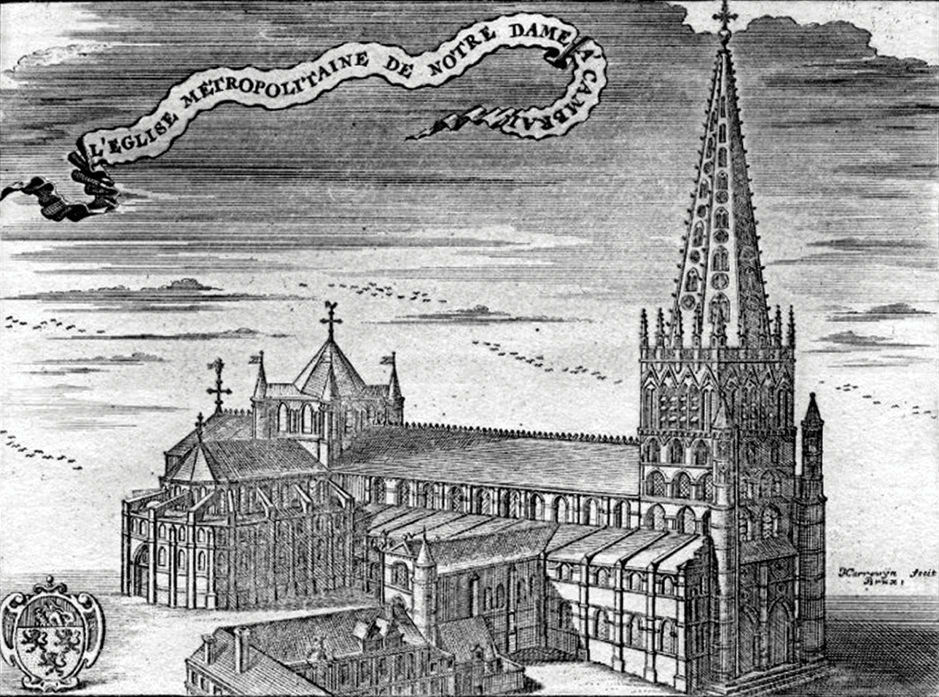
The duchy of Burgundy under Philip the Good (1419-67)
Philip III (aka Philip the Good), duke of Burgundy: the most powerful of the Burgundian dukes, ruled for almost 50 years; “Grand Duke of the West”
Scion of French royal house Valois, cousin/rival to both the French & English kings; expanded Burgundian territories and alliances
Burgundian cathedral schools: at Cambrai, Antwerp, Bruges, etc.
Best musical and general “classical” education on the continent
Graduates virtually guaranteed lucrative jobs at churches/courts
Franco-Flemish (i.e., Burgundian) musicians fought over by European courts, especially in Italy (the oltremontani)

Slide 6
The duchy of Burgundy under Philip the Good (1419-67)
Philip III (aka Philip the Good), duke of Burgundy: the most powerful of the Burgundian dukes, ruled for almost 50 years; “Grand Duke of the West”
Scion of French royal house Valois, cousin/rival to both the French & English kings; expanded Burgundian territories and alliances
Philip’s library: one of the largest in Europe (still in existence)
Over 900 manuscripts, 2/3 collected by Philip himself
Includes music from Burgundy, other parts of Europe, both present and past (the best pieces/composers are collected)

Slide 7
The duchy of Burgundy under Philip the Good (1419-67)
Guillaume de Machaut (ca. 1300-1377): celebrated French poet & composer
Gorgeous manuscripts in the best libraries (including Philip of Burgundy’s), including “collected works” (poetry & music)
Served a variety of noble patrons
Associated with the Cathedral of Notre-Dame of Rheims
Works: primarily polyphonic chansons in these formes fixes:
Ballade – aabC
Rondeau – ABaAabAB
Virelai – AbbaA

Slide 8
The duchy of Burgundy under Philip the Good (1419-67)
Guillaume de Machaut (ca. 1300-1377): celebrated French poet & composer
Gorgeous manuscripts in the best libraries (including Philip of Burgundy’s), including “collected works” (poetry & music)
Musical style of Machaut’s polyphonic chansons
Mostly in 3 voices, using ballade/cantilena style:
Lively melody in the cantus (dominant voice, written first)
Tenor: supports/cadences with the cantus
Contratenor: middle voice, written last (textural filler)
Tenor/contratenor untexted, likely instrumental

Slide 9
The duchy of Burgundy under Philip the Good (1419-67)
Guillaume de Machaut (ca. 1300-1377)
Rose liz printemps verdure
A 4-voice rondeau (ABaAabAB)
Tune is shared by cantus & triplum
Musical style:
Cantilena style: only cantus is texted; other voices instrumental (?)
Much expanded size: 37-measure refrain (161 measures total)
Uses the rhythmic & notational innovations of Ars Nova:
Both duple & triple meter, syncopation, hemiola, hocket
Decorative melismas start each poetic line

Slide 10
The duchy of Burgundy under Philip the Good (1419-67)
Guillaume de Machaut (ca. 1300-1377)
Rose liz printemps verdure
A 4-voice rondeau (ABaAabAB)
Tune is shared by cantus & triplum
Rondeau’s structure emphasized poetically (by rhymes) & musically:
Hierarchy of cadences: strong at end of refrain, weaker at half-point
At half-point: Phrygian cadence (bII-IV-bVII to I-V-V) on D
At end: double-leading-tone cadence (II-#IV-#VII to I-V-I) on C
Musical rhyme: same music ends both halves of the refrain (with different cadences)

Slide 11
The duchy of Burgundy under Philip the Good (1419-67)
Gilles Binchois (aka Gilles de Bins; ca. 1400-1460) – leading 15th-century Burgundian composer, singer, organist (trained at a cathedral school)
1427-53: member of Philip the Good’s court chapel (until retirement)
Works: primarily 3-voice chansons (rondeaux and ballades)
Deuil angoisseux (ca. 1435) – ceremonial ballade (aa’bC)
A setting of the famous poetic lament by Christine de Pisane (ca. 1364-1430)
Cantilena style: tune in the cantus supported by instrumental tenor/contratenor
Use of musical rhyme (a’, C end with the same melisma; b, C start the same)

Slide 12
The duchy of Burgundy under Philip the Good (1419-67)
Gilles Binchois (aka Gilles de Bins; ca. 1400-1460) – leading 15th-century Burgundian composer, singer, organist (trained at a cathedral school)
1427-53: member of Philip the Good’s court chapel (until retirement)
Works: primarily 3-voice chansons (rondeaux and ballades)
Deuil angoisseux (ca. 1435) – ceremonial ballade (aa’bC)
A setting of the famous poetic lament by Christine de Pisane (ca. 1364-1430)
Cantilena style: tune in the cantus supported by instrumental tenor/contratenor
Use of musical rhyme (a’, C end with the same melisma; b, C start the same)
Sweet, bright, consonant sonorities, melodic/harmonic triads – why? how?

Slide 13
The duchy of Burgundy under Philip the Good (1419-67)
“The English guise”: a sweeter, more consonant musical style preferred in England; traveled to Burgundy with the English armies during 100-Year War
Strong influence on Burgundian musicians, who learned it by:
Working at the English continental courts (e.g., Binchois)
Interacting with the English composers present in Burgundy
Characteristics of “the English guise”:
Strong preference for imperfect consonances (full triads, parallel 3rds/6ths, chains of 6/3 chords)
Careful control of the dissonance (prepared/resolved, never on strong beats/important words)
Syllabic text settings in a homophonic texture

Slide 14
The duchy of Burgundy under Philip the Good (1419-67)
“The English guise”: a sweeter, more consonant musical style preferred in England; traveled to Burgundy with the English armies during 100-Year War
Most influential composer: John Dunstable (1390-1453)
Spent his career on the continent
Works/interacts with Burgundian composers
Works and compositional style:
Primarily sacred genres (Mass movements, motets, other liturgical works)
Preference for consonant 3-voice settings (with or without a borrowed chant)
Strongly consonant, triad-dominated textures; e.g., Quam pulchra es

Slide 15
The duchy of Burgundy under Philip the Good (1419-67)
“The English guise”: a sweeter, more consonant musical style preferred in England; traveled to Burgundy with the English armies during 100-Year War
Most influential composer: John Dunstable (1390-1453)
Spent his career on the continent
Works/interacts with Burgundian composers
Quam pulchra es: a 3-voice motet (a short setting of Latin sacred text)
A freely composed setting (no borrowed chant)
Text from The Song of Songs is set syllabically (except the final Alleluia)
Musical structure, rhythmic patterns, cadence placement guided by poetry
Homophonic texture filled with triads and 6/3 chords (except at cadences)

Slide 16
The duchy of Burgundy under Philip the Good (1419-67)
“The English guise”: a sweeter, more consonant musical style preferred in England; traveled to Burgundy with the English armies during 100-Year War
Burgundian composers merge it with their own compositional manner
Result: Franco-Flemish polyphony – new international musical style
Johannes Tinctoris (ca. 1435-1511) – Burgundian-trained theorist and composer
In 1477 treatise Liber de arte contrapucti, states:
Musical art has reached the state of perfection (i.e., Franco-Flemish music)
Dunstable named as one of the founding fathers of the “new art”
“Music written more than 40 years ago is not worth hearing”

Slide 17
The duchy of Burgundy under Philip the Good (1419-67)
“The English guise”: a sweeter, more consonant musical style preferred in England; traveled to Burgundy with the English armies during 100-Year War
Burgundian composers merge it with their own compositional manner
Result: Franco-Flemish polyphony – new international musical style
Martin le Franc (ca. 1410-1461) – Burgundian court poet
In 1440 poem Le Champion des Dames (dedicated to Philip the Good), states:
Earlier French composers (successors to Machaut) used to “astonish all Paris,” but their “discant” pales before that of Burgundian composers, who have learned “to make a pleasant concord [i.e., consonant] sound”

Slide 18
The duchy of Burgundy under Philip the Good (1419-67)
“The English guise”: a sweeter, more consonant musical style preferred in England; traveled to Burgundy with the English armies during 100-Year War
Burgundian composers merge it with their own compositional manner
Result: Franco-Flemish polyphony – new international musical styl
Martin le Franc (ca. 1410-1461) – Burgundian court poet
In 1440 poem Le Champion des Dames (dedicated to Philip the Good), states:
The English guise they wear with grace, they follow Dunstable aright
And thereby they’ve learned apace to make their music gay and bright

Slide 19
The duchy of Burgundy under Philip the Good (1419-67)
“The English guise”: a sweeter, more consonant musical style preferred in England; traveled to Burgundy with the English armies during 100-Year War
Burgundian composers merge it with their own compositional manner
Result: Franco-Flemish polyphony – new international musical styl
Martin le Franc (ca. 1410-1461) – Burgundian court poet
In 1440 poem Le Champion des Dames (dedicated to Philip the Good), states:
The English guise they wear with grace, they follow Dunstable aright
And thereby they’ve learned apace to make their music gay and bright
Composers praised & depicted in the poem: Binchois and Guillaume Du Fay

Slide 20
The duchy of Burgundy under Philip the Good (1419-67)
Guillaume Du Fay (Dufay, ca. 1397-1474): illustrious international career, reputation as the greatest Burgundian composer of his generation
Trained at Cambrai cathedral school; worked in Burgundy, Italy, Savoy
Retired as a wealthy canon of Cambrai Cathedral
Honorary member of Philip of Burgundy’s court chapel
Other patrons include the duke of Savoy, Carlo Malatesta (Pesaro & Rimini), and Pope Eugenius IV
Du Fay head of the Papal chapel in Rome, Florence, Bologna

Slide 21
The duchy of Burgundy under Philip the Good (1419-67)
Guillaume Du Fay (Dufay, ca. 1397-1474): illustrious international career, reputation as the greatest Burgundian composer of his generation
As head of Papal chapel, accompanied pope Eugenius IV into exile in Florence
1436: dedication of Cathedral of Santa Maria del Fiore
Cathedral of Florence with the Brunneleschi dome
Nuper rosarum flores: Du Fay’s grand motet for dedication ceremony
4 voices: two tenors, motetus, triplum
Borrowed chant: Terribilis est locus iste (“How awesome is this place”)
Introit of the Mass for a dedication of a church

Slide 22
The duchy of Burgundy under Philip the Good (1419-67)
Guillaume Du Fay (Dufay, ca. 1397-1474): illustrious international career, reputation as the greatest Burgundian composer of his generation
As head of Papal chapel, accompanied pope Eugenius IV into exile in Florence
1436: dedication of Cathedral of Santa Maria del Fiore
Cathedral of Florence with the Brunneleschi dome
Nuper rosarum flores: intricate number symbolism in poetry/music
7 (“Virgin Mary”): lines per stanza, syllables per line
4 (“temple”): number of poetic stanzas, voices, sections
14 (“days of Temple dedication feast”): no. of pitches in chant fragment

Slide 23
The duchy of Burgundy under Philip the Good (1419-67)
Guillaume Du Fay (Dufay, ca. 1397-1474): illustrious international career, reputation as the greatest Burgundian composer of his generation
As head of Papal chapel, accompanied pope Eugenius IV into exile in Florence
1436: dedication of Cathedral of Santa Maria del Fiore
Cathedral of Florence with the Brunneleschi dome
Nuper rosarum flores: intricate number symbolism in poetry/music
28 (7 x 4, 14 x 2): total no. of poetic lines; total no. of pitches in 2 tenors of each section; total no. of tempora (time units) in each section
14 tempora: motetus/triplum duet; 14 tempora – 4 voices w/ chant

Slide 24
The duchy of Burgundy under Philip the Good (1419-67)
Guillaume Du Fay (Dufay, ca. 1397-1474): illustrious international career, reputation as the greatest Burgundian composer of his generation
As head of Papal chapel, accompanied pope Eugenius IV into exile in Florence
1436: dedication of Cathedral of Santa Maria del Fiore
Cathedral of Florence with the Brunneleschi dome
Nuper rosarum flores: intricate number symbolism in poetry/music
6:4:2:3 – proportions that govern the architecture of the Temple & Cathedral of Florence; mathematical ratios of perfect consonances
Temporal proportions of 4 sections, chant time signatures in each

Slide 25
The duchy of Burgundy under Philip the Good (1419-67)
Guillaume Du Fay (Dufay, ca. 1397-1474): illustrious international career, reputation as the greatest Burgundian composer of his generation
As head of Papal chapel, accompanied pope Eugenius IV into exile in Florence
1436: dedication of Cathedral of Santa Maria del Fiore
Cathedral of Florence with the Brunneleschi dome
Nuper rosarum flores: Du Fay’s isorhythmic motet for dedication ceremony
Color (repeated pitch pattern): 4 x 2 (1 statement of chant per tenor/section)
Talea (repeated rhythmic pattern): 4 x 2 (proportions mirror the 6:4:2:3 ratio)

Slide 26
The duchy of Burgundy under Philip the Good (1419-67)
Guillaume Du Fay (Dufay, ca. 1397-1474): illustrious international career, reputation as the greatest Burgundian composer of his generation
As head of Papal chapel, accompanied pope Eugenius IV into exile in Florence
1436: dedication of Cathedral of Santa Maria del Fiore
Cathedral of Florence with the Brunneleschi dome
Nuper rosarum flores: Du Fay’s isorhythmic motet for dedication ceremony
Color (repeated pitch pattern): 4 x 2 (1 statement of chant per tenor/section)
Talea (repeated rhythmic pattern): 4 x 2 (proportions mirror the 6:4:2:3 ratio)
“Ars Nova” technique for chant-based sacred genres: motet, Mass

Slide 27
The duchy of Burgundy under Philip the Good (1419-67)
Messe de Nostre-Dame (ca. 1365) by Guillaume de Machaut:
First known polyphonic setting of the Mass Ordinary by a single composer
Composed for Notre-Dame of Rheims to be performed in his memory
4 voices sing continuously (no monophonic sections)
Characteristic descending motif in all movements (a unifying device)
Gloria, Credo: freely composed (no chant)
Kyrie, Sanctus, Agnus Dei, Ite Missa Est, Amen of Credo:
Based on local Rheims-area chants associated with Virgin Mary
Use isorhythmic procedures in tenor, other voices

Slide 28
The duchy of Burgundy under Philip the Good (1419-67)
Messe de Nostre-Dame (ca. 1365) by Guillaume de Machaut:
First known polyphonic setting of the Mass Ordinary by a single composer
Composed for Notre-Dame of Rheims to be performed in his memory
Agnus Dei: 3 sections (ABA: Agnus Dei-III repeats Agnus Dei-I)
Incipits are freely composed; qui tollis settings isorhythmic
One chant statement (i.e., color) per section (3 total)
Agnus Dei-I/III: isorhythmic tenor & contratenor (2 taleas each) against free, faster, syncopated upper voices
Agnus Dei-II: pan-isorhythmic (6 shorter taleas in all voices)

Slide 29
The duchy of Burgundy under Philip the Good (1419-67)
Guillaume Du Fay (Dufay, ca. 1397-1474): illustrious international career, reputation as the greatest Burgundian composer of his generation
Standardized, perfected the first type of the polyphonic Mass Ordinary setting: a cyclical cantus-firmus Mass
Signature genre of Franco-Flemish composers
5 movements (no Ite missa est)
Same borrowed melody in tenor of all movements – the cantus-firmus
May be chant or secular song (cantus or tenor); gives the Mass its title
NB: from now on, a “Mass” (with rare exceptions) means a polyphonic setting of the Mass Ordinary

Slide 30
The duchy of Burgundy under Philip the Good (1419-67)
Philip III (aka Philip the Good), duke of Burgundy: the most powerful of the Burgundian dukes, ruled for almost 50 years; “Grand Duke of the West”
Involved himself in both secular and ecclesiastical European politics
Strong religious sentiment at court (e.g., Order of the Golden Fleece)
“Feast of the Pheasant” (17 Feb 1454, Lille):
A grand banquet hosted by Philip the Good
Philip & his knights publicly took the “Oath of the Pheasant”: a vow to launch a crusade to free Constantinople from the Turks

Slide 31
The duchy of Burgundy under Philip the Good (1419-67)
Philip III (aka Philip the Good), duke of Burgundy: the most powerful of the Burgundian dukes, ruled for almost 50 years; “Grand Duke of the West”
Involved himself in both secular and ecclesiastical European politics
Strong religious sentiment at court (e.g., Order of the Golden Fleece)
“Feast of the Pheasant” (17 Feb 1454, Lille):
A grand banquet hosted by Philip the Good
Lavish entertainment included music by Du Fay, Binchois, other Burgundian composers, performed by members of the court chapel

Slide 32
The duchy of Burgundy under Philip the Good (1419-67)
Philip III (aka Philip the Good), duke of Burgundy: the most powerful of the Burgundian dukes, ruled for almost 50 years; “Grand Duke of the West”
Involved himself in both secular and ecclesiastical European politics
Strong religious sentiment at court (e.g., Order of the Golden Fleece)
L’homme armé (“The Armed Man”) – monophonic chanson (by Du Fay?)
Performed at, possibly composed for the Feast of the Pheasant
Militant text, melodic trumpet calls encourage all Christians to arm themselves for battle (i.e., “the armed man” = Christ, Philip the Good)
Tune: a very popular Mass cantus-firmus (over 30 known settings)

Slide 33
The duchy of Burgundy under Philip the Good (1419-67)
Missa L’homme armé (ca. 1460) by Guillaume Du Fay: a cantus-firmus Mass
First known example of a L’homme armé Mass
Borrowed melody appears at least once in the tenor of all 5 movements
4 voices (cantus, tenor, contratenor altus, contratenor bassus) do not share range
SATB quartet of soloists – not chorus!
Other compositional techniques:
Reduced textures: most movements, sections begin with a duet
Motto technique: all movements begin with a variant of the same duet
Melodic/rhythmic gestures of L’homme armé appear in other voices

Slide 34
The duchy of Burgundy under Philip the Good (1419-67)
Missa L’homme armé (ca. 1460) by Guillaume Du Fay: a cantus-firmus Mass
First known example of a L’homme armé Mass
Borrowed melody appears at least once in the tenor of all 5 movements
4 voices (cantus, tenor, contratenor altus, contratenor bassus) do not share range
SATB quartet of soloists – not chorus!
Gloria: cantus-firmus appears once per section (Et in terra pax; Qui tollis)
Each section starts with a duet, then continues in a 4-voice texture
1st statement of the cantus-firmus in long notes
2nd statement is 1/3 faster; creates a hemiola effect

Slide 35
The duchy of Burgundy under Philip the Good (1419-67)
Missa L’homme armé (ca. 1460) by Guillaume Du Fay: a cantus-firmus Mass
First known example of a L’homme armé Mass
Borrowed melody appears at least once in the tenor of all 5 movements
4 voices (cantus, tenor, contratenor altus, contratenor bassus) do not share range
SATB quartet of soloists – not chorus!
Agnus Dei: 3 distinct sections, each treats the cantus-firmus differently
Agnus-I: starts with a duet, then 1 complete statement in the tenor
Agnus-II: faster, 3-voice section (no tenor!); opening cantus-altus duet in imitation, then a variant of L’homme armé tune fast in bassus

Slide 36
The duchy of Burgundy under Philip the Good (1419-67)
Missa L’homme armé (ca. 1460) by Guillaume Du Fay: a cantus-firmus Mass
First known example of a L’homme armé Mass
Borrowed melody appears at least once in the tenor of all 5 movements
4 voices (cantus, tenor, contratenor altus, contratenor bassus) do not share range
SATB quartet of soloists – not chorus!
Agnus Dei: 3 distinct sections, each treats the cantus-firmus differently
Agnus-III: opening returns to slower pace, 4 voices of Agnus-I
Two statements of the cantus-firmus: slow in retrograde, then in its original form but melodically ornamented and twice as fast

